Slide 1
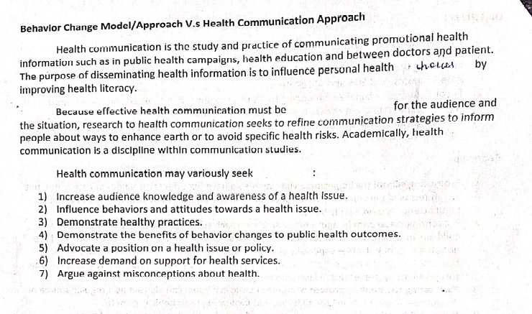

Slide 2
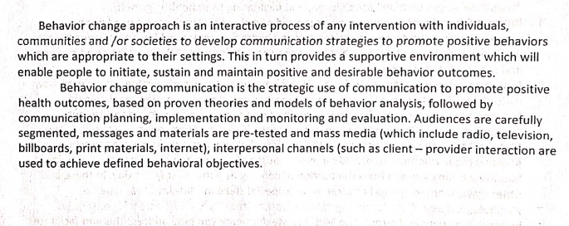

Slide 3
School Health Curriculum
These are health aspects that need to be incorporated in the curriculum. Excessive use and immersion into IT space and digital technology, accompanied with extended screen time, wrong body postures and diminishing use of the natural neural system are leading to serious ailments. All these factors may have huge adverse impact on the mental and physical health of the children in the long run.

Slide 4
A standard and well-structured Health Education Curriculum must necessarily include the following components:
Nutrition and Fitness
Health Hygiene and Wellness
Disease Control and Prevention
Safety and First Aid
Community and Environmental Health
Mental and Emotional Health
Substance Abuse and Prevention
Adolescent Education

Slide 5
School Health Education Programme (SHEP)
SHEP has a vision to create a well informed and healthy school population equipped with life skills to maintain healthy habits, attitudes and behaviour to achieve educational goals and contribute effectively to national development.

Slide 6
Objective of SHEP
To provide skills-based health education that promotes the physical, social and mental development of school-age children
To promote a healthy friendly, physical, psychosocial and conducive learning environment for children to enhance school retention and academic competence while preventing ill-related absenteeism.
Promote safety and prevent injury within the school environment and the general community
Promote the provision of safe school infrastructure that is age-appropriate, well ventilated, well illuminated, disability and gender-friendly

Slide 7
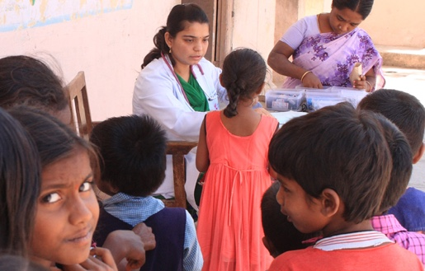
FRCH
The Foundation for Research in Community Health (FRCH) was established in 1975 as a non-profit voluntary organization in the field of health care

Slide 8
Nali Kali
Nali-Kali class room process: Nali-Kali teaching learning is adopted in a situation where multi grade, multilevel, existing and self-pace of learning is regarded. Pupils participate actively throughout learning process; lessens the burden of the teacher; class room interaction is maximum; no examination trauma/anxiety. Childs natural instincts such as curiosity, dynamism, exploration find a place for chanalization.
Pupils participate actively throughout learning process; lessens the burden of the teacher; class room interaction is maximum; no examination trauma/anxiety.

Slide 9
A child who remained absent from school for several days or weeks due to seasonal agricultural work or illness or temporary migration can re-enter the learning continuum at the level where she left off without having to go through the distress of catching up large chunks of portions missed out.

Slide 11
If school sanitation and hygiene facilities are deficient, schools become perilous place to spread the diseases & pollute the natural environment in such a way that it causes health hazards for the community at large. Access to sanitation has been recognized by the UN as a human right, a basic service requirement to live a decent life.

Slide 12
unicef
Role of unicef in school health

