Slide 1
CPEH UNIT 1 - 4

Slide 2
UNIT 1
Health – Definition by WHO
"Health is a state of complete physical, mental and social well-being and not merely the absence of disease or infirmity."
Well being – Internet atanga en tur
The maintenance of physical, mental, and emotional being stability and balance can be term as well being.

Slide 3
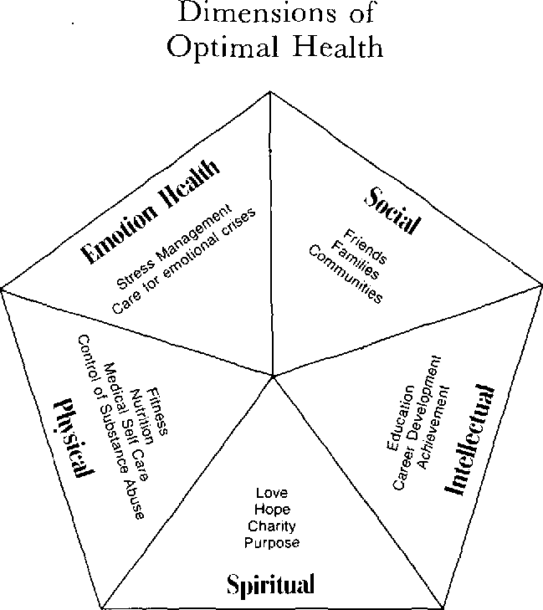

Slide 4
Biomedical vs social health model :-
Biomedical or Bioengineering is the application of engineering principles to the field of biology and health care. Bioengineering work with Doctors, the therapist and researchers to develop systems equipment and diseases in order to solve clinical problems.
Social health :- Social health is one's ability to form meaningful personal relationship with others. It is also an indication of one's ability to manage in social situations and behave accordingly. Matters such as stress can damage someone's social health although autism also makes social health difficult to sustain.

Slide 5
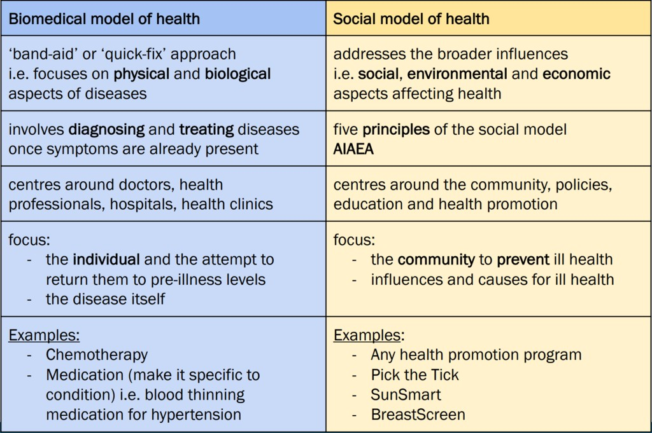

Slide 7
Social determinants of health
Social determinants of health reflect the social factors and physical conditions of the environment in which people are born, live, learn, play, work, and age
Many factors have an influence on health. In addition to our individual genetics and lifestyle choices, where we are born, grow, live, work and age also have an important influence on our health.

Slide 9
Unit 2

Slide 10
RELATIONSHIP BETWEEN HEALTH AND EDUCATION
There is a strong connection between education and health. A healthy mind produces a healthy person.
People with more education are more likely to learn about healthy behaviors. Educated patients may be more able to understand their health needs, follow instructions
Poor health leads to lower levels of schooling. children with asthma and other chronic illnesses may experience recurrent absences.
Family of educated increases schooling and also improves health.

Slide 11
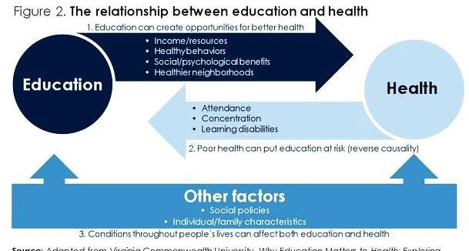

Slide 12
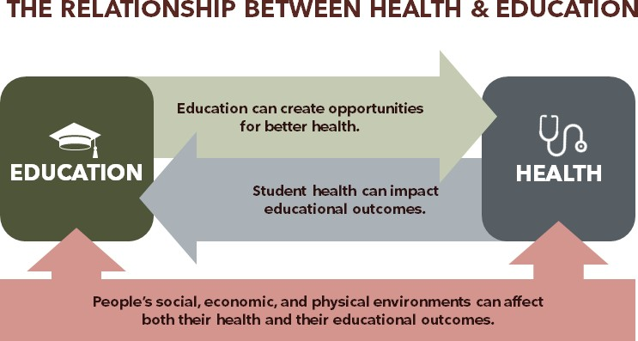

Slide 13
Malnutrition and hunger in childhood
underweight
Undernutrition
Stunting
Deficiency
Malnutrition
Overnutrition
Obesity

Slide 14
Morbidity mapping
Indicator of a health status. A group or Individual.
Example:-
Can be a prevalence of diseases in a population.
Number of new cases during a defined period.

Slide 15
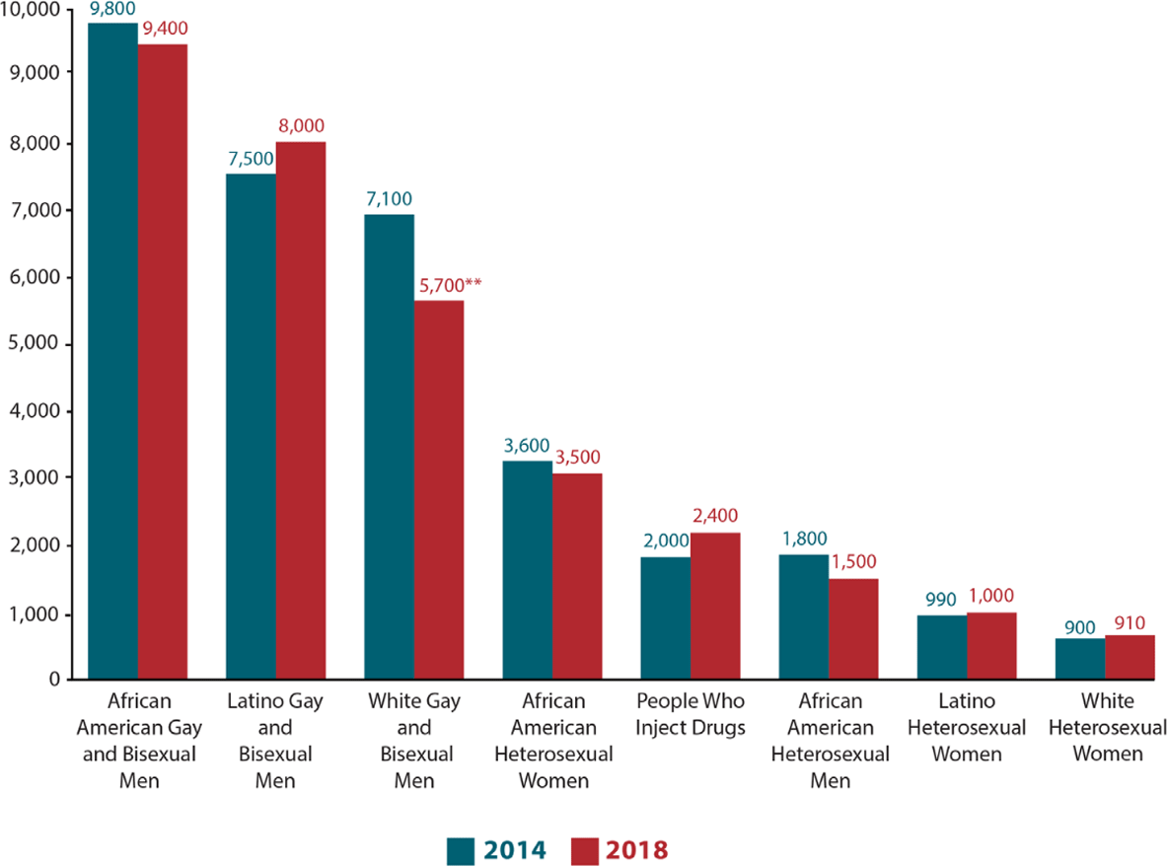

Slide 16
Chart on prevalence of sickness among absentee students
Sickness
diarhhoea Fever Bronchitis injury

Slide 17
Children health perception
How children think of themselves? As healthy or unhealthy individual.
Children's beliefs of health risks may be particularly important in terms of health promotion and health education. Their belief system of health risks is developed through their own past experiences, that is most of the illnesses that affect children involve infection.

Slide 18
Methods to understandhealth s children perception
Each participant was asked to create two drawings, depicting illness and health respectively, and to give an explanatory title for each. Drawings were categorised into three main categories, depending on the aspect of illness or health depicted, namely biomedical, psychosocial and lifestyle

Slide 19
Measurement of child health perception
Among others, the following categories were identified in terms of health: being happy, being active, feeling good, the lack of pain and health-promoting activities, particularly such hygienic issues as clean food or personal hygiene.
Mostly children demonstrated a biomedical approach to health.

Slide 20
CLASSROOM HUNGER
Riltam takin ram retheiah chuan naupang sikul kal hi an tam em em. Hei hi Midday meal in tihreh a tum ber pawh a ni.
Kids at risk of hunger may be less equipped to reach their full potential, lack concentration and focus in classroom.
How can teacher aid in classroom hunger?

Slide 21
Unit 3

Slide 22
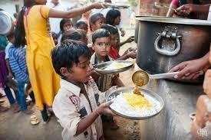

Slide 23
OBJECTIVES
Improving the nutritional status of children in classes I – VIII in Government, Local Body and Government aided schools
protecting children from classroom hunger
increasing school enrolment and attendance
attracting children from disadvantaged sections to provide education.
improved socialisation among children belonging to all castes.
addressing malnutrition
social empowerment through provision of employment towomen.

Slide 24
Nutritional content of MDM
According to MHRD’s notice, dated June
24, 2019, the current cooking cost per child per day is Rs. 4.48 for primary
and Rs. 6.71 for upper primary children.
According to MHRD, the children in
primary school must be provided with at least 450 calories with 12 grams of protein through MDM while the
children in upper primary schools get 700 calories with 20 grams of protein.

Slide 25
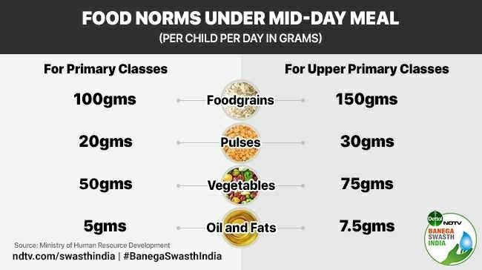
Components of MDM

Slide 26
MDM and Classroom hunger
Preventing classroom hunger: Many children reach school on an empty stomach. Even children who have a meal before they leave for school get hungry by the afternoon and are not able to concentrate- especially children from families who cannot give them a lunch box or are staying a long distance away from school. Mid day meal can help to overcome this problem by preventing “classroom hunger”.

Slide 27
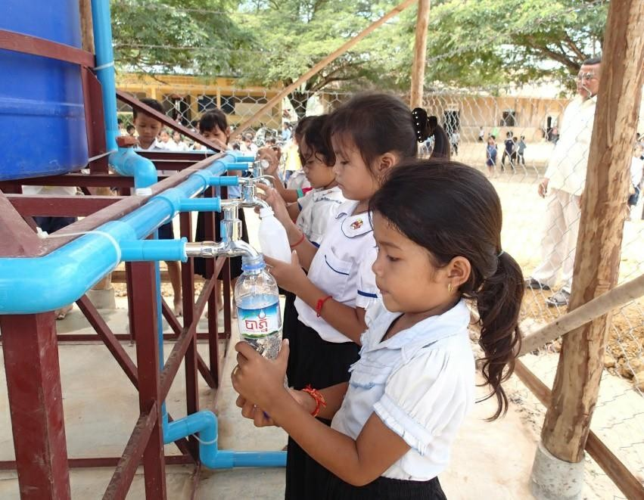
1.CLEAN DRINKING WATER SUPPLY:
Provision of safe drinking water.
Covered Storage of water.
Be adequate drinking water accordin g to the school strength

Slide 28
2. CLEAN TOILETS ANDURINALS
Toilet block should be cleaned twice a day.
Separate toilet blocks for girls in schools.
Lighting and ventilation should
be proper,
water supply adequate.
should be
Toilet and urinal etiquettes should be taught by the teachers regularly like: Bolt the door properly, Use water to clean up.

Slide 29
3. SAFE FOOD
Safe food is very important for children to keep them healthy and away from diseases.
Teachers can prevent food borne illness by educating children
Encouraging hand wash before and after meals

Slide 30
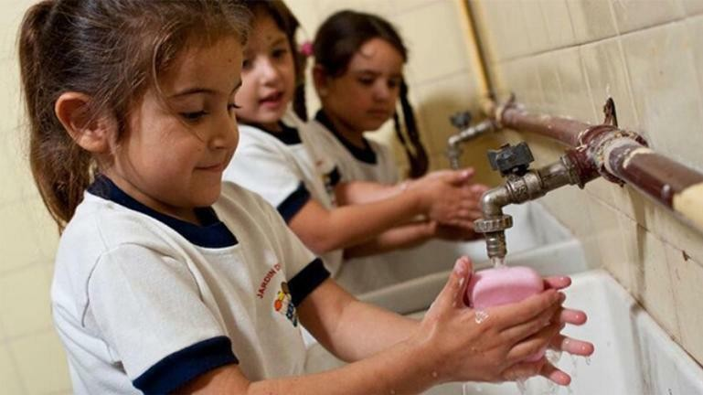
4. HAND WASHINGFACILITY
Children are taught to wash hands before and after meals.
Teacher should also encourage
them to wash hands even after handling animals, throwing garbage, visiting sick, after playing, sneezing, coughing,
using toilets and urinals.
Child friendly wash basins at minimum height.
Proper arrangement of soaps
and hand wash liquid.

Slide 32
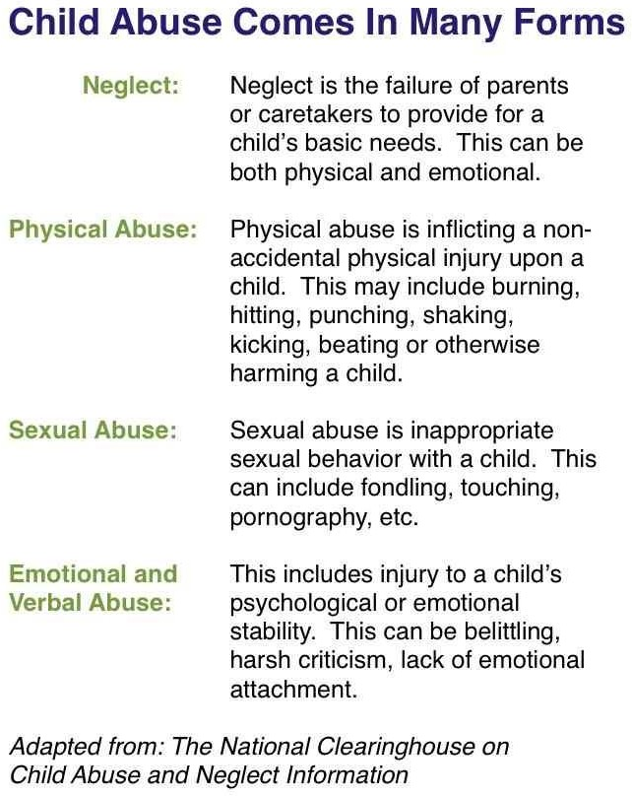

Slide 33
Nali Kali chungchang internet velah in lo chhiar ve ang .. Emaw pdf ka lo dah hi en zuaih2 a nimai e….
Nali kali chu nuam taka naupangin lehkha an zir theihnan a hmalakna a ni ber. Lecture ngaihthlak tawp aiah discussion te , thil en tawp aiah tih ve zel te..etc

Slide 34
Health education builds student's knowledge, skills, and positive attitudes about health. Health education teaches about physical, mental, emotional and social health. It motivates students to improve and maintain their health, prevent disease, and reduce risky behaviours.

Slide 35
What is behaviour change approach in health promotion?
-The behavioural change model is a preventive approach and focuses on lifestyle behaviours that impact on health. It seeks to persuade individuals to adopt healthy lifestyle behaviours, to use preventive health services, and to take responsibility for their own health.
Approach of Behavioural change model:
1) prevent disease and death, 2) promote a better quality of life, and 3) create environmental conditions in which people can be healthy by intervening at the institutional, community, and societal level.

Slide 36
Behavioural change model hi individual approach a ni ber a. Mihringin a hrisel nana a nun dan thlak a kawk.
https://youtu.be/8BmhtlmaO-4
Health communication approach is the study and practice of communicating promotional health information, such as in public health campaigns, health education, and between doctor and patient. The purpose of disseminating health information is to influence personal health choices by improving health literacy.
Health awareness campaign

