Slide 1
What is the first word that you speak?

Slide 2
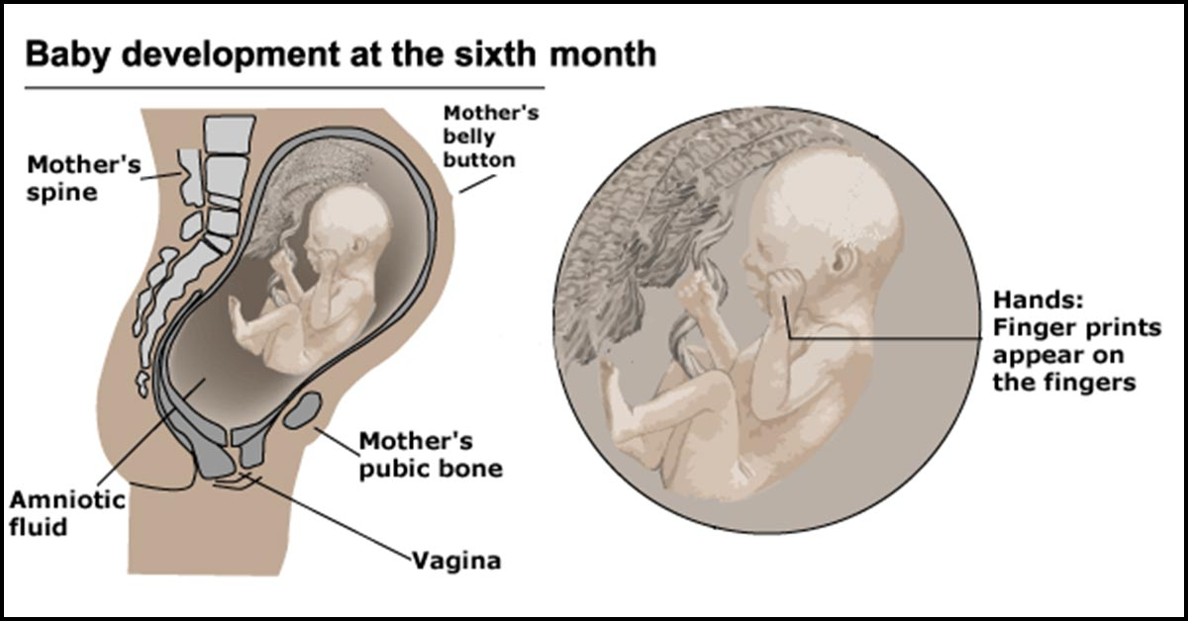
Womb : Baby able to hear voice

Slide 3
Language acquistion
The process by which we learn to speak , write, or even use sign language in meaningful ways to communicate.
The process by which humans acquire the capacity to perceive and comprehend language , as well as to produce and use words and sentences to communicate.
Many Linguist think differently.

Slide 4
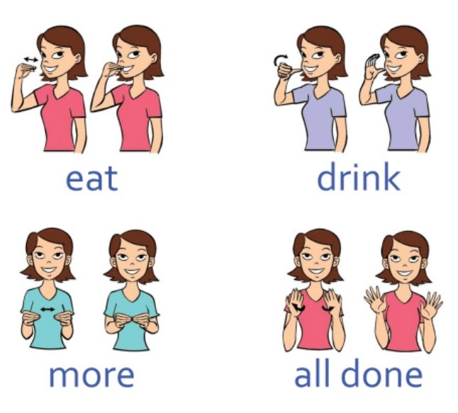
Sign language
Do babies pay more attention to sign language

Slide 5
Learning a language not just learning facts.
The capacity to successfully use language requires one to acquire a range of tools including phonology , morphology , syntax , semantics, and an extensive vocabulary .

Slide 8
PHONOLOGY
Can you get me a glass of water.
All sound of language can be produce differently on different context.
This pattern and study of variation is known as phonology
Chutney… Paro

Slide 9
Morphology
What is a word?
Hungry, Hangry,Angry.
Lexemes – deep,hole,deephole
Morphemes
i am a victim = ya zhertva

Slide 11
Orthography
Study of correct spelling according to accepted usage.
Concerned with letters and their sequences in words.
An example of orthography is spelling definitely as "d-e-f-i-n-i-t-e-l-y.

Slide 12
RELATION OF LANGUAGE AND SOCIETY
Language is a system of communication between individual and social phenomenon(SP).
SP is any behaviours, actions, or events that takes place because of social influence
Socio linguistic – Study of language and society, how the people around you and your heritage can change the way you speak.
Sociolinguist believe that language is dynamic and subjected to change with change in society.

Slide 13
Social context
Social context focus on relationships between a persons language and their social identity.
Language varieties differ between groups separated by social variables (e.g., ethnicity, religion, status, gender, level of education, age, etc.) and/or geographical barriers (a mountain range, a desert, a river, etc.)
Language <----> Culture

Slide 14
The sort of language that one uses depends on their social background and social identity.
All the time language is changing because of social context and the social context made language to change.

Slide 15
Language effect society by the sexist language
Sexist language is the representation of male and female unequally, as if one sex is denoted less human or less power with compare to other sex. It is more often the disadvantage of women in language use.
If you use like chairman or fireman, it implies that only man can do the job and women were left out. The form of word can influence the view of things.

Slide 16
Language a tool of power in social life
Language is a tool of power in all sphere of society-religion,education,media,etc.
Language of the rich and powerful is often made as a standard variety.
Instead of using multilingualism resource in classroom, it remains largely monolithic in nature. It is only those children who speak the standard language benefit this education.
Monolingual system nourish negative stereotype of the heritage language of children.

Slide 17
Access to Language
Access to Power

Slide 18
Language and power in a society

Slide 19
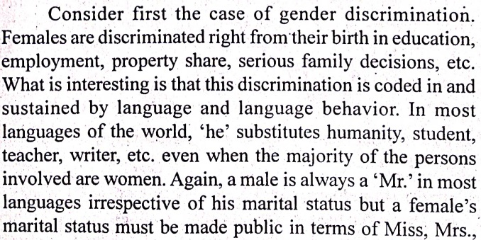

Slide 20
Language acquisition and Language learning: Pre school and early school year

Slide 21
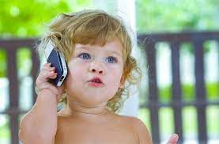
There is a positive relationship between child’s learning and family culture and environment.
Early readers are brought up in Literacy rich environment.
Child constantly interacting by family soon develop language and able to express ideas.
Children acquire language through interaction - not only with their parents and other adults, but also with other children.

Slide 22
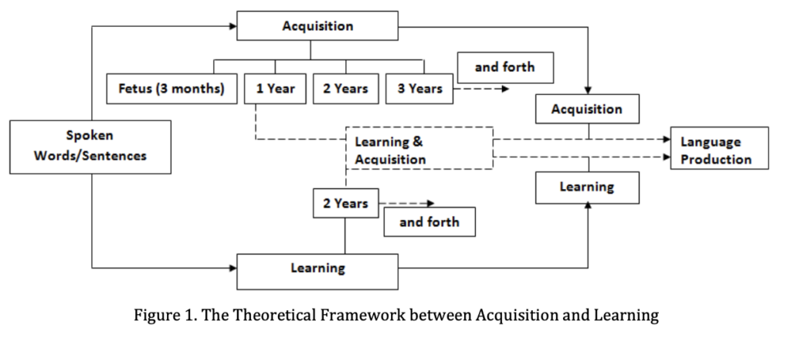
An affectionate environment in home helps the child’s to develop self confidence and allows to experiment and learn new things.

Slide 23
Pre School

Slide 24
Early years

Slide 25
Teachers role in language acquisition/learning
Teachers can identify the learners specific needs and to ascertain which level of literacy a child should enter.
In pre school teachers can stimulate rich learning environment by pasting posters, colourful materials on wall.
Singing of rhymes that include word play and repetition.
Read aloud to children and encourage them to story telling.
Using riddles and chants.
Expose children to magazine, story, poems,etc.

Slide 26
Children background and school experience in language learning
The environment a child develops in has influences on language development. The environment provides language input for the child to process. Speech by adults to children help provide the child with correct language usage repetitively.
Cultural and socioeconomic differences have been shown to influence development. An example of cultural differences in language development can be seen when comparing the interactions of mothers in the United States with their infants with mothers in Japan. Mothers in the United States use more questions, are more information-oriented, and use more grammatically correct utterances with their 3-month-olds.Mothers in Japan, on the other hand, use more physical contact with their infants, and more emotion-oriented, nonsense, and environmental sounds, as well as baby talk, with their infants.

Slide 27
First words for English-speaking children tend to be nouns. The child labels objects such as a cup or a ball. In a verb-friendly language such as Chinese, however, children may learn more verbs. This may also be due to the different emphasis given to objects based on culture. Chinese children may be taught to notice action and relationship between objects while children from the United States may be taught to name an object and its qualities (color, texture, size, etc.).

Slide 28
Factors affecting language learning

Slide 33
Three language formula
Need for three-language formula
The committee’s report observes that learning languages are an important part of a child’s cognitive development.
The primary aim is to promote multilingualism and national harmony.
The three language formula is well intended to bring about national unity by bridging the linguistic gap between the states.

Slide 34
Article 350A facilities for instruction in mother-tongue at the primary stage, first 5 years of education.
Article 350B provides for the establishment of a Special Officer for linguistic minorities. The Officer shall be appointed by the President and shall investigate all matters relating to the safeguards for linguistic minorities, reporting directly to the President.
Eighth Schedule of the Constitution of India contains a list of 22 recognised official languages.

Slide 35
Three-language formula
First language: It will be the mother tongue or regional language.
Second language: In Hindi speaking states, it will be other modern Indian languages or English. In non-Hindi speaking states, it will be Hindi or English.
Third Language: In Hindi speaking states, it will be English or a modern Indian language. In the non-Hindi speaking state, it will be English or a modern Indian language.

